Slide 1


Slide 2

K-MEANS & FRIENDS
EXPLORING CLUSTERING WITH PHOTOGRAPHS
shaurya agarwal

Slide 3

Outline
me motivate you
me movie you
me math you
me method you
you more me

Slide 4
me motivate you
what are we talking about again?

Slide 5
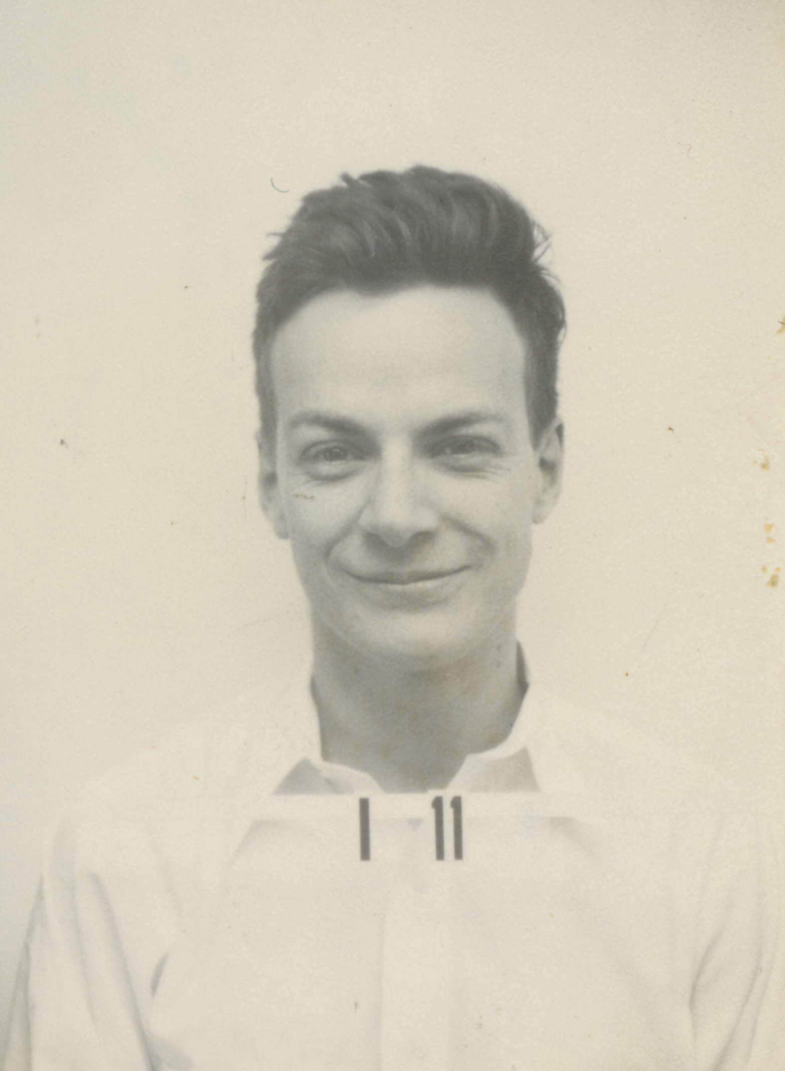
teach / learn
this dude
Notes:
https://commons.wikimedia.org/wiki/File:Feynman-richard_p.jpg?uselang=en#Licensing

Slide 6
teach / learn
it’s hubris to think that anyone can come here and teach you

Slide 7
teach / learn
no one can teach you

Slide 8
teach / learn
but you can learn

Slide 9
teach / learn
the best anyone can hope for is to inspire you to learn

Slide 10
teach / learn
that’s the only greatness i aspire to today

Slide 11
wip
this is a larger workshop i am building and is a work-in-progress

Slide 12
wip
thank you for partnering in helping me build it

Slide 13
wip
we’ll switch around a lot of windows for now

Slide 14
wip
close your eyes if you see something you should not ;)

Slide 15
me movie you
a rather unusual use case for k-means

Slide 16
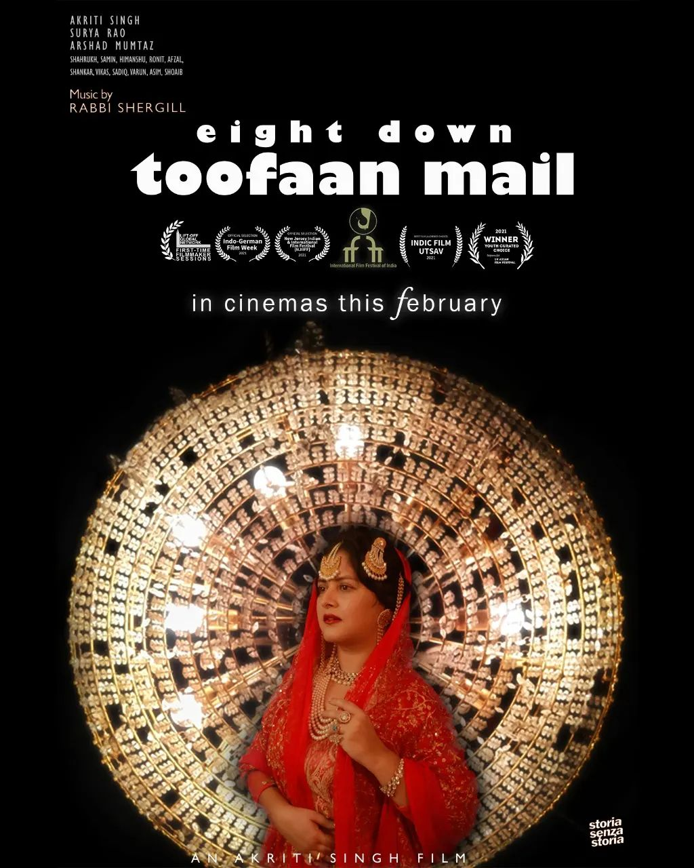
i got to do this
cinematography
on
a
budget
powered
by
python
Notes:
https://commons.wikimedia.org/wiki/File:Feynman-richard_p.jpg?uselang=en#Licensing

Slide 17
first principles
the best cinematography has exceptional control on color

Slide 18
first principles
showcase what inspired the film’s cinematography

Slide 19
first principles - colors
one, or two or a few
Notes:
see this: https://www.youtube.com/watch?v=YCJXS4hvOsU

Slide 20
first principles - colors
one, or two or a few but no more

Slide 21
first principles - colors
for each scene,
the director has ascribed meaning to these colors
and is using them to tell a story

Slide 22
first principles - colors
so, play as much as you like,
as long as these colors are (approximately) constant

Slide 23
pre-production
there’s a lot of prep
you select a color palette for each scene

Slide 24
pre-production
there are expensive cameras and studio setup that offer great control over the process

Slide 25
pre-production
a typical day may cost 10s of lakhs of rupees for camera and lighting

Slide 26
pre-production
for a 10 day shoot, interior and exterior

Slide 27
pre-production
we had 30K total

Slide 28
pre-production
so i had to leverage my technical knowhow to identify key colors,
tell a story around them

Slide 29
pre-production
or lose my limbs*
* we had a great director and a very dedicated team

Slide 30
enter Kandinsky
built this ages ago using javascript

Slide 31
enter Kandinsky
revived in Python

Slide 32
key insight
light is wavelengths

Slide 33
key insight
eyes respond to light

Slide 34
key insight
and to colors: long wavelength, medium wavelength, short wavelength

Slide 35
key insight
film and camera sensors do too, but differently

Slide 36
CIE XYZ 1931
they devised a standard based on how human eyes respond to various wavelengths

Slide 37
CIE Lab*
3 dimensional model (we have 3 cones remember) to represent how we see color

Slide 38
ACES, ARRI, SONY, sRGB, Rec.709, Rec.2020, etc. etc.
all models build up from the perceptual model – this is how all films manage color

Slide 39
color mastering
so the colors we decided on with the director, had to be identified at a perceptual level and kept consistent throughout the production as they information travelled from the camera sensor to the computer monitor to the cinema projector to the mobile phone and laptop screens…
(and TVs, screw TVs, but more on them later)

Slide 40
color mastering
long wavelength, medium wavelength, short wavelength
if i could capture the key colors perceptually, i can manage the rest of the process

Slide 41
how do you pick colors?
google ‘QUANTIZATION’

Slide 42
how do you pick colors?
i used k-means++ to do it

Slide 43
.
let’s see how

Slide 44
me math you
how clustering works

Slide 45
me method you
let’s look at some code

Slide 46
YOU MORE ME
JOIN THE DISCUSSION, GITHUB, MAKE THIS BETTER

Slide 47
open-source
Eight Down Toofaan Mail is now on YouTube https://www.youtube.com/watch?v=VnHPtozfhRU
this project on github: https://github.com/shauryashaurya/kandinsky
join me

